Slide 1


Introduction To TSQL
Unit 1

Slide 2
Definitions
SQL - Structured Query Language
SQL is probably one of the simplest languages you will ever learn. It is also very simple to underestimate. DON’T!!! This is arguably the most powerful language you will learn.
SQL is a set oriented language. It was designed and built to manage groups of data.
ER Diagram - Entity Relationship diagram
An ER Diagram, also known as a database schema, gives you a graphical depiction of the database you are working with.

Slide 3
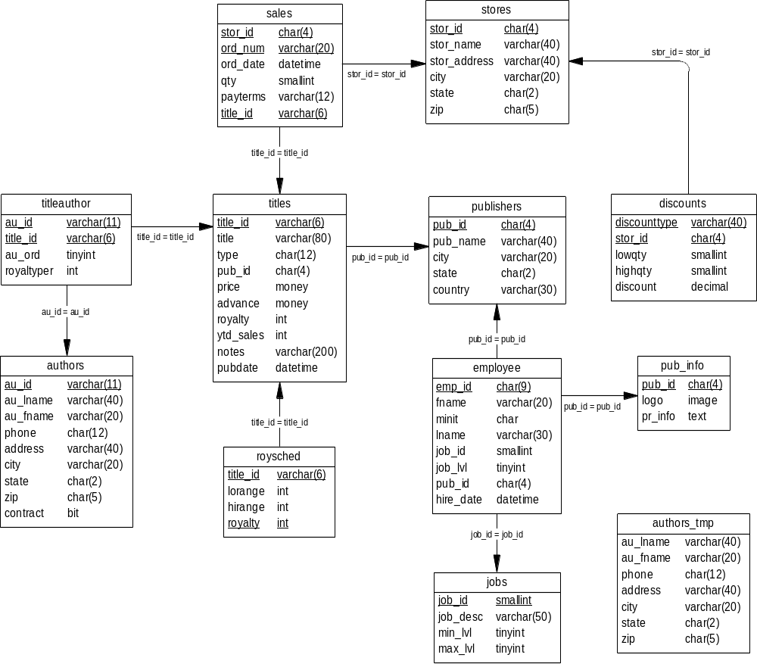
PUBS Database

Slide 4
Unit 1
Goals
What is a database
What is a table
Rows and columns
Connecting to your database
Change databases
Overview of PUBS database
Simple select
Select all columns from a table
Select specific columns from a table
Concatenate two columns
Create a query to give formatted output

Slide 5
Databases
At the most basic level a database is really just a file.
Databases come in all shapes and sizes. Some are large and some are small. But each database generally serves a particular purpose.
Examples: Tracking employee payroll, sales data on a particular sales line, stock data for a particular industry
All databases are made up of objects. The most important object (and the one we will learn how to use in this class) is a table.

Slide 6
Tables
A table is a storage structure made up of rows and columns. (Sort of like a spreadsheet.)
Due to the differing terminologies, there are interchangeable sets of terms:
Database Mathematical Data Processing
Table Relation File
Row Tuple Record
Column Attribute Field
These terms are used interchangeably, but we will generally use the table – row – column terminology

Slide 7
Tables cont.
You will also hear a table referred to as an entity. (Hence the name Entity – Relationship Diagram)
In the most basic sense, an entity is a person, place, thing, or idea.
Entities usually become tables
Example: books, publishers, titles, authors

Slide 8
Connect to a database
In this class we will use a tool called ISQL/W. This stands for Interactive SQL / Windows. This is where we will execute all of our queries from. A query as the term implies is a question we ask the database.
In other environments you will see this query tool called by different names. It is generally referred to as just isql.
Regardless of name, they all perform the same purpose. This is to give you an interface for sending SQL statements and receiving results.

Slide 9
SQL Server Login
Startup ISQL/W
Login window
A SQL Server can have many different databases running on it at the same time.
Database setup on the server
Assign databases
Your first SQL statement
use <database>
This tells the SQL Server what database you will be using to perform your queries.
Example: use PUBS1

Slide 10
Verify your database
To check the database you are accessing use:
select db_name()
Throughout this course some of the things we discuss will be MS SQL Server specific. The DBMS you are using should have a command or function similar to this, but not necessarily the same.

Slide 11
Basic syntax rules
SQL keywords (use, select, from, where, etc.) are case insensitive.
select is the same as SELECT is the same as SeLeCt, etc.
However depending on the DBMS (Database Management System), the columns might be case sensitive.
select title_id from titles is not necessarily the same as
SELECT TITLE_ID FROM TITLES
The databases we have setup on our server are case insensitive.

Slide 12
Rules cont.
Spacing does not matter (for the most part).
select title_id…
  is the same as
  select title_id…
However, you must still separate words. You can not use the following:
selecttitle_id… This will give a syntax error, because SQL Server must be able to find your SQL keywords.

Slide 13
Rules cont.
Carriage returns are ignored
select title_id from titles
is the same as
select title_id
from titles
The spacing and carriage returns just make reading your SQL a lot easier.
The general format used by most people is to place the separate clauses of the statement on different lines

Slide 14
PUBS Database
PUBS is a database for a fictitious book distributor that sells books to book resellers. This is the database for which you have an ER diagram for.
ER diagram explanation
You will generally get an ER diagram at each client when you begin work on a project. If you don’t have one, ask for one. This will save time in trying to determine what data is where and how everything is linked together. If you can’t get one, don’t panic! There are ways to get the database to tell you what it contains.

Slide 15
Select
SELECT Statement Retrieves rows from the database.
SELECT [ALL | DISTINCT] <select_list> INTO [<new_table_name>]
[FROM <table_name> [, <table_name2> [..., <table_name16>]]
[WHERE <clause>] [GROUP BY <clause>] [HAVING <clause>] [ORDER BY <clause>]
[COMPUTE <clause>] [FOR BROWSE]
where <table_name> | <view_name> =
[[<database>.]<owner>.]{<table_name>. | <view_name>.}
<joined_table> =
{<table_name> CROSS JOIN <table_name> | <table_name> {INNER | LEFT [OUTER] | RIGHT [OUTER] |
FULL [OUTER]} JOIN <table_name> ON <search_conditions>} <optimizer_hints>
One or more of the following, separated with a space:
[INDEX = {<index_name> | <index_id>}]
[NOLOCK] [HOLDLOCK] [UPDLOCK] [TABLOCK] [PAGLOCK] [TABLOCKX] [FASTFIRSTROW]
WHERE <clause> =
WHERE <search_conditions>
GROUP BY <clause> =
GROUP BY [ALL] <aggregate_free_expression> [[, <aggregate_free_expression>]...]
[WITH {CUBE | ROLLUP}]
HAVING <clause> =
HAVING <search_conditions>
ORDER BY <clause> =
ORDER BY {{<table_name>. | <view_name>.}<column_name> | <select_list_number> | <expression>} [ASC | DESC] [...{{<table_name16>. | <view_name16>.}<column_name> |
<select_list_number> | <expression>} [ASC | DESC]]
COMPUTE <clause> =
COMPUTE <row_aggregate>(<column_name>) [, <row_aggregate>(<column_name>)...]
[BY <column_name> [, <column_name>]...]

Slide 16
Select
A select statement is used to retrieve data from a database. As you can see from the syntax above, a select statement can get very complicated.
Depending on the type of SQL statement you are using most of this is optional.

Slide 17
Select
In order to get information from the database, you must tell the database what you are looking for. The first step along this journey is to get some simple information from the database.
select 'Mary had a little lamb.'
  --------------
  Mary had a little lamb.
  (1 row affected)
If you ever want to return a specific phrase from a database, use this construct.

Slide 18
Select
An asterisk (*) is used to designate all columns in a table.
  select *
We also need to tell it which table to get the data from.
  select * from authors
The main sections in every SQL statement are called clauses. The three clauses will will focus on are the select, from, and where.

Slide 19
Select
select * from authors
au_id au_lname au_fname phone ...
----------- -------------------- -------------------- ------------
172-32-1176 White Johnson 408 496-7223...
213-46-8915 Green Marjorie 415 986-7020...
238-95-7766 Carson Cheryl 415 548-7723...
267-41-2394 O'Leary Michael 408 286-2428...
274-80-9391 Straight Dean 415 834-2919...
341-22-1782 Smith Meander 913 843-0462...
409-56-7008 Bennet Abraham 415 658-9932...
427-17-2319 Dull Ann 415 836-7128...
472-27-2349 Gringlesby Burt 707 938-6445...
486-29-1786 Locksley Charlene 415 585-4620...
527-72-3246 Greene Morningstar 615 297-2723...
648-92-1872 Blotchet-Halls Reginald 503 745-6402...
672-71-3249 Yokomoto Akiko 415 935-4228...
712-45-1867 del Castillo Innes 615 996-8275...
722-51-5454 DeFrance Michel 219 547-9982...
724-08-9931 Stringer Dirk 415 843-2991...
724-80-9391 MacFeather Stearns 415 354-7128...
756-30-7391 Karsen Livia 415 534-9219...
807-91-6654 Panteley Sylvia 301 946-8853...
846-92-7186 Hunter Sheryl 415 836-7128...
893-72-1158 McBadden Heather 707 448-4982...
899-46-2035 Ringer Anne 801 826-0752...
998-72-3567 Ringer Albert 801 826-0752...
(23 row(s) affected)

Slide 20
Select
We can limit the columns returned by specifying them instead of using *.
select au_lname, au_fname from authors
  au_lname au_fname
  ---------------------------------------- --------------------
  White Johnson
  Green Marjorie
  Carson Cheryl
  O'Leary Michael
  Straight Dean
  Smith Meander
  Bennet Abraham
  Dull Ann
  Gringlesby Burt
  Locksley Charlene
  Greene Morningstar
  Blotchet-Halls Reginald
  Yokomoto Akiko
  del Castillo Innes
  DeFrance Michel
  Stringer Dirk
  MacFeather Stearns
  Karsen Livia
  Panteley Sylvia
  Hunter Sheryl
  McBadden Heather
  Ringer Anne
  Ringer Albert
  (23 row(s) affected)

Slide 21
Select
When you specify columns, you do not have to specify them in the order they appear in the table.
You could have also executed the following:
  select au_fname, au_lname from authors
  au_fname au_lname
  -------------------- ----------------------------------------
  Johnson White
  Marjorie Green
  Cheryl Carson
  Michael O'Leary
  Dean Straight
  Meander Smith
  Abraham Bennet
  Ann Dull
  Burt Gringlesby
  ...
  (23 row(s) affected)

Slide 22
Concatenation
We can also combine data together. This is called concatenation.
We really want to display the first name and the last name separated by a space and then the rest of the data. The plus symbol (+) is the most widely used symbol for concatenation. (A double pipe || is sometimes used, but very rarely.)
select au_fname+au_lname from authors
JohnsonWhite
MarjorieGreen
CherylCarson
MichaelO'Leary
DeanStraight
MeanderSmith
AbrahamBennet
AnnDull
BurtGringlesby
CharleneLocksley
MorningstarGreene
ReginaldBlotchet-Halls
AkikoYokomoto
Innesdel Castillo
...
(23 row(s) affected)

Slide 23
Concatenation cont.
Concatenation is used for string (character) data. If a concatenation operator (+) is used on numeric data, the data is simply added together.
  select title_id,price,advance from titles
  title_id price advance
  -------- -------------------------- --------------------------
  BU1032 19.99 5,000.00
  BU1111 11.95 5,000.00
  BU2075 2.99 10,125.00
  BU7832 19.99 5,000.00
  MC2222 19.99 0.00
  ...
  (18 row(s) affected)
  select title_id,price+advance from titles
  title_id
  -------- --------------------------
  BU1032 5,019.99
  BU1111 5,011.95
  BU2075 10,127.99
  BU7832 5,019.99
  MC2222 19.99
  ...
  (18 row(s) affected)

Slide 24
Select
By combining the first select (selecting a constant) with the select on authors we did above, we can get some formatted output from the database.
select au_fname+’ ‘ + au_lname, city + ’,’ + state + ’ ‘+zip from authors
  -------------------------------------- -----------------------------
  Johnson White Menlo Park,CA 94025
  Marjorie Green Oakland,CA 94618
  Cheryl Carson Berkeley,CA 94705
  Michael O'Leary San Jose,CA 95128
  Dean Straight Oakland,CA 94609
  Meander Smith Lawrence,KS 66044
  Abraham Bennet Berkeley,CA 94705
  Ann Dull Palo Alto,CA 94301
  Burt Gringlesby Covelo,CA 95428
  ...
  (23 row(s) affected)
One of the many things you should take away from this class is the ability to put together a SQL statement like the one above. This simple principle saves DBAs hundreds of hours and year and makes their jobs much more simple.

Slide 25
Aliases
The title for our previous result set isn't too informative, and we really don't want to display our formula.
We can rename or alias a column in two ways
  Use a space and then the alias
  Specify the keyword as and then the alias
select au_fname+’ ‘ + au_lname, city + ’,’ + state + ’ ‘+zip Name_Address from authors
select au_fname+’ ‘ + au_lname, city + ’,’ + state + ’ ‘+zip as Name_Address from authors

Slide 26
Aliases
We can apply aliases in two places within our SQL statements
  Select clause
  From clause
By specifying an alias in the select clause we can rename the column headers for the output
By specifying an alias in the from clause, we can save some typing and also perform some higher level queries which will require this. (This will be demonstrated in subsequent units.)

Slide 27
Unit 1 Review
A database is a collection of objects, the most prominent of which is a table.
A table consists of rows/tuples/records and columns/attributes/fields.
use <dbname> allows you to select a database
SQL keywords are not case sensitive.
Spacing and carriage returns are not needed.
You can include a constant in your result set by hadding it just as you would a column
An * allows you to select all columns in a table
A + is used for concatenating two strings.

Slide 28
Unit 1 Exercises
Time allotted for exercises is 30 minutes

